Slide 1

Impact of breweries on Housing prices in North Carolina
Harold Flack, Zack Capets, Joe Rafferty, Jalil Woods, Chrison Mills
Notes:
Speaker: Chrison

Slide 2
Project goal: Determine whether Brewery openings impact local housing prices in the state of north Carolina.
Do Breweries make an area “boom” or are breweries just opening in booming areas?
Can we separate the impact of breweries from overall trends in housing data during the same time period?
How long does it take for a brewery to have an impact on the housing prices?
Notes:
Speaker: Joe

Slide 3
What Data Do WE need and where do we get it?
Brewery Data
Housing Data
Notes:
Speaker: Jalil

Slide 4
What Data Do WE need and where do we get it?
Brewery Data
Name
Zip Code
Date of Opening
Notes:
Speaker: Zack

Slide 5
Yelp reviews
Pitfalls: Not necessarily all-inclusive
Google Maps / Geocode data
Pitfalls: No info on timing (i.e opening date)
Government Data (State ABC Board)
Winner!
Approaches considered:
Notes:
Speaker: Zack

Slide 6
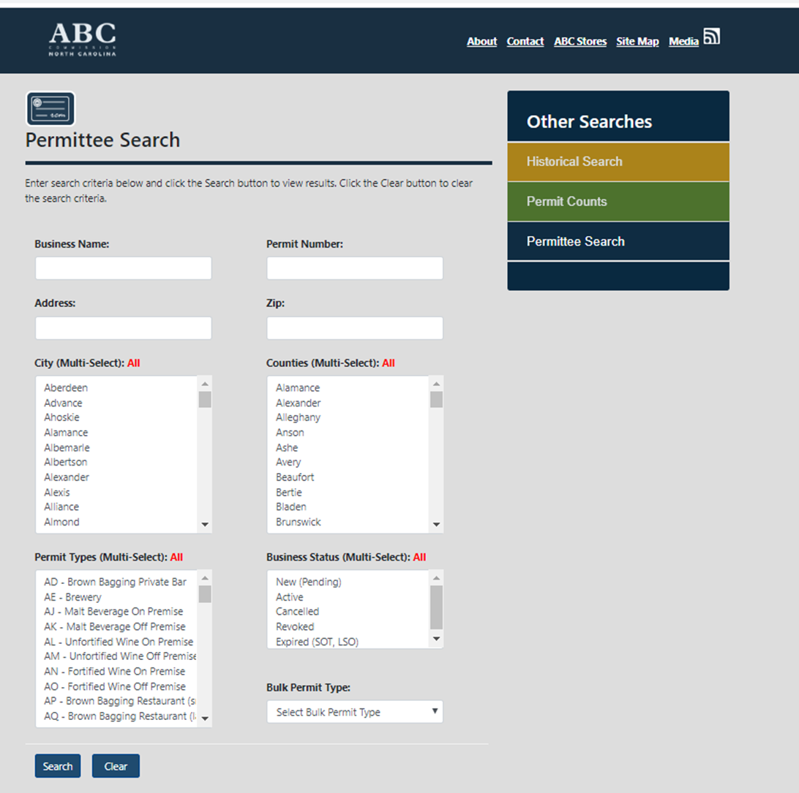
ABC Board Permit Data
Data Source:
abc.nc.gov/Search/Permit
Search parameters:
All counties
“AE – Brewery” permit type
All Business Statuses
Notes:
Speaker: Zack

Slide 7
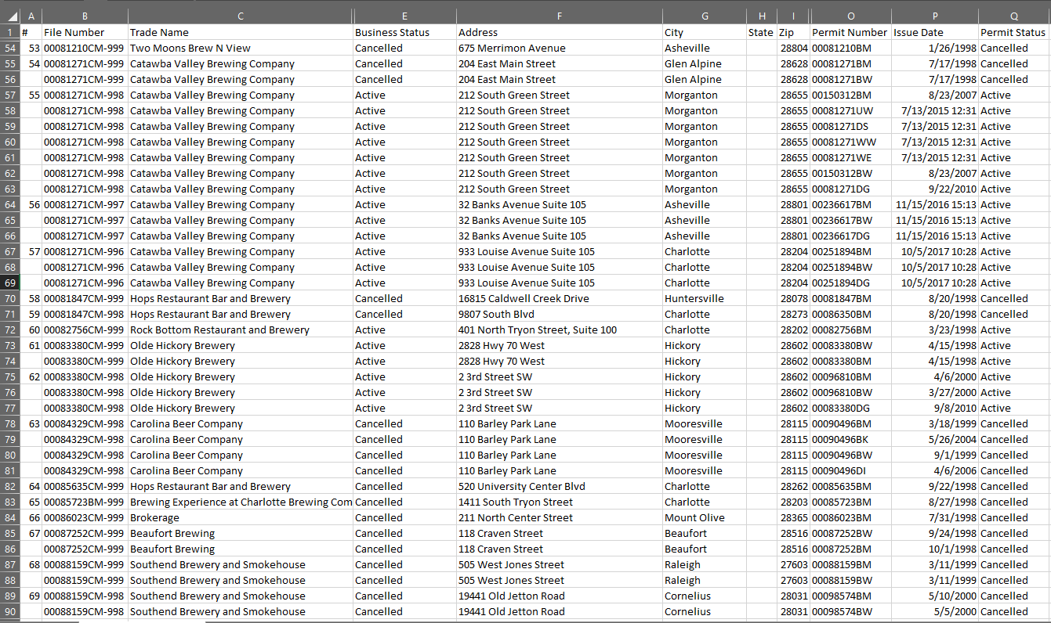
Data output:
CSV data set
Brewery name
Business and permit status
Address (with components separated)
Permit number
Problems/cleaning required:
Missing data (no issue date)
Multiple records per brewery (different permit types)
Inactive (defunct) businesses
Multiple date formats to interpret
Assumptions:
Brewery opening date is within a short time of ABC permit issue date
Notes:
Speaker: Zack

Slide 8
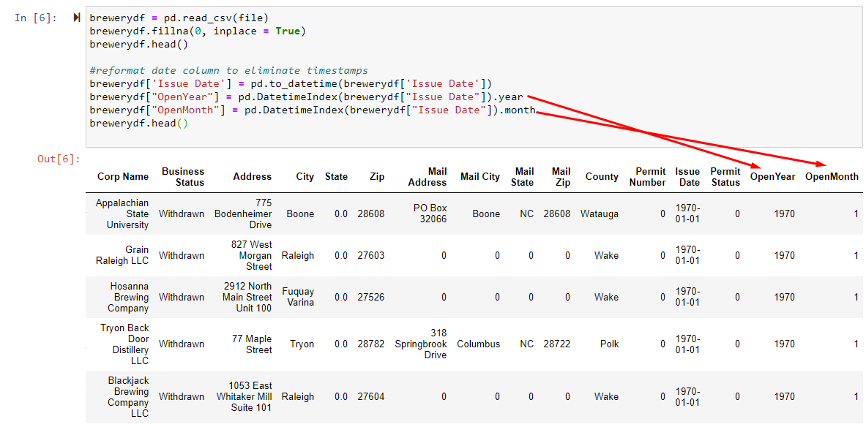
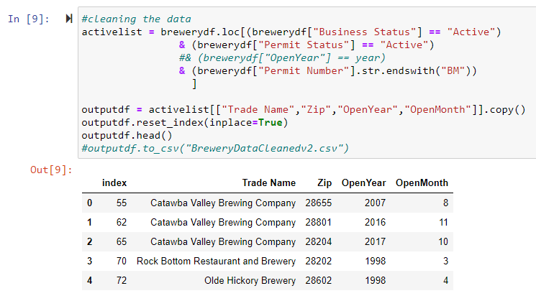
Fill blanks, format dates
Include only active permits/businesses, “BM” permit type (brew on premises)
Notes:
Speaker: Zack

Slide 9
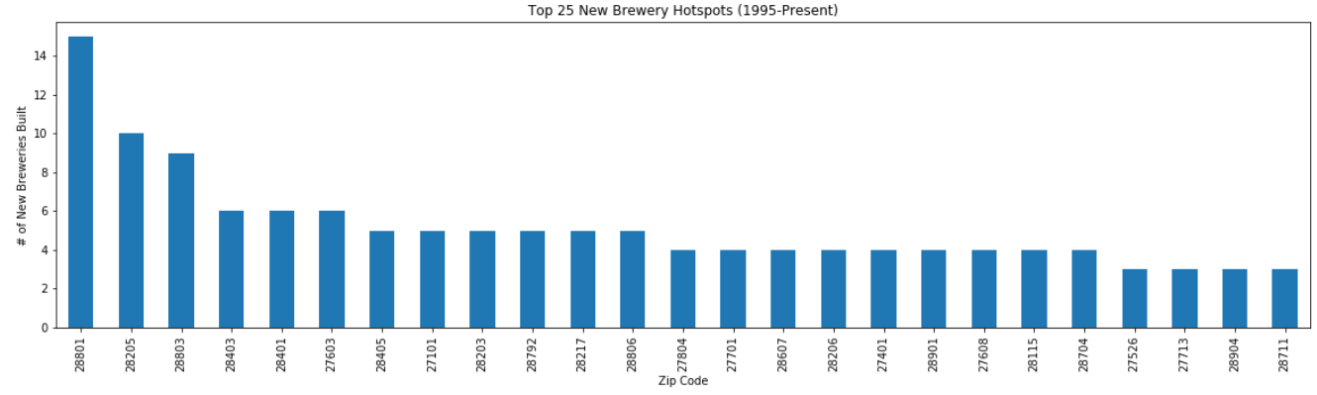
Plots of Brewery prevalence in NC
Notes:
Speaker: Chrison

Slide 10
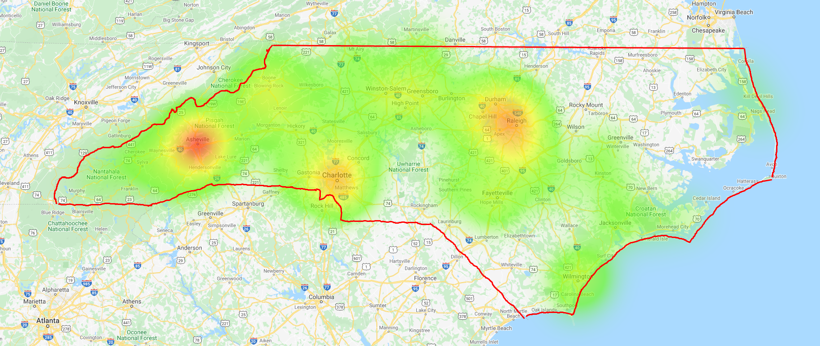
Plots of Brewery prevalence in NC
Notes:
Speaker: Zack

Slide 11
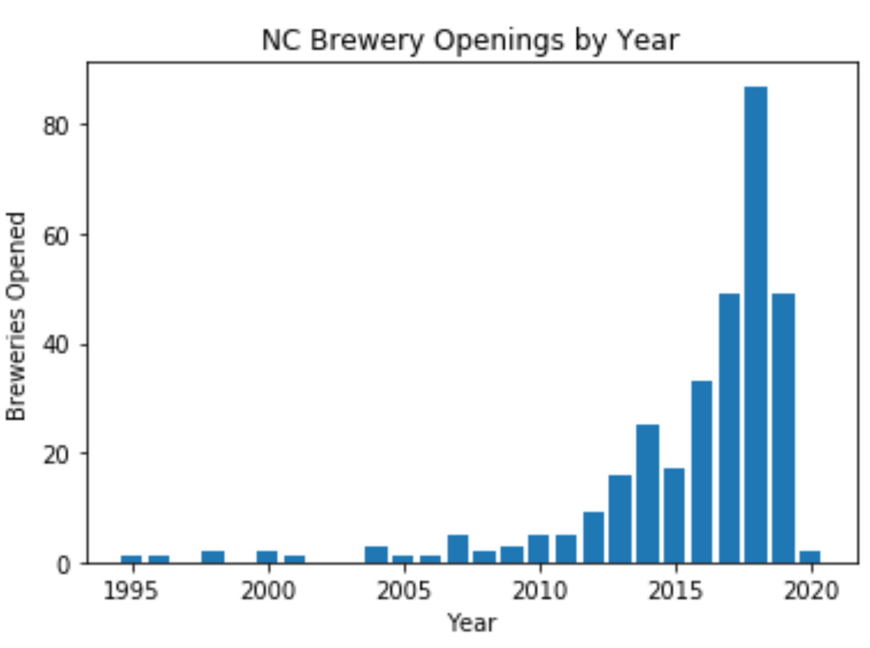
Plots of Brewery prevalence in NC
Notes:
Speaker: Jalil

Slide 12
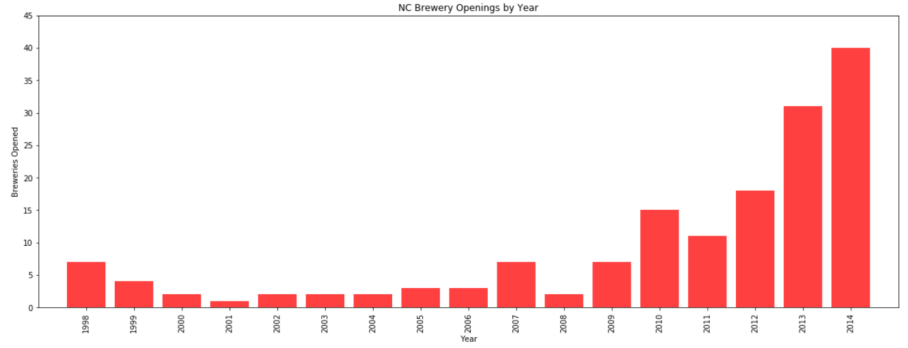
Plots of Brewery prevalence in NC
Notes:
Speaker: Harry

Slide 13
What Data Do WE need and where do we get it?
Housing Data
Location
Price metrics
Time period
Notes:
Speaker: Harry

Slide 14
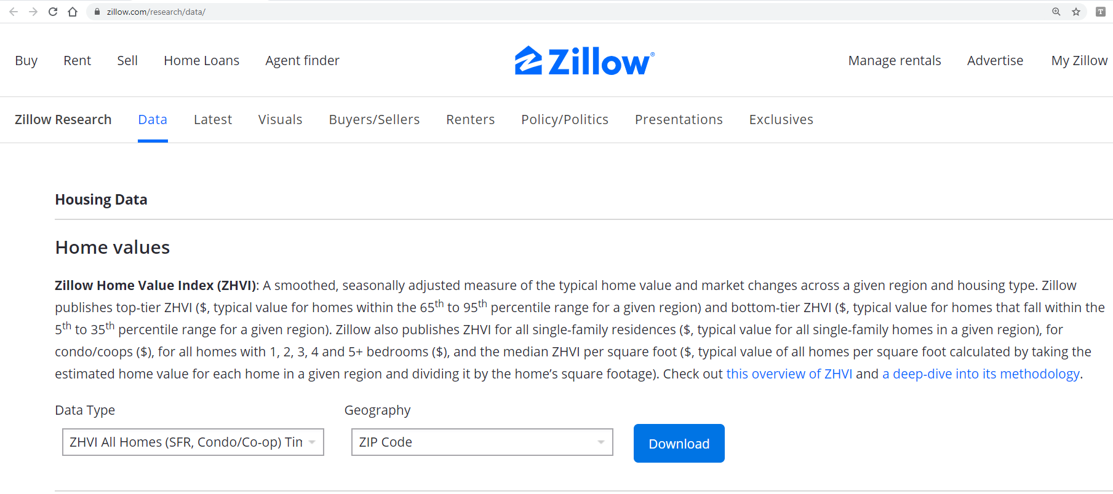
Zillow home value index (zillow.com/research/data)
Search Parameters:
ZHVI All Homes
Aggregated by Zip Code
Notes:
Speaker: Harry

Slide 15
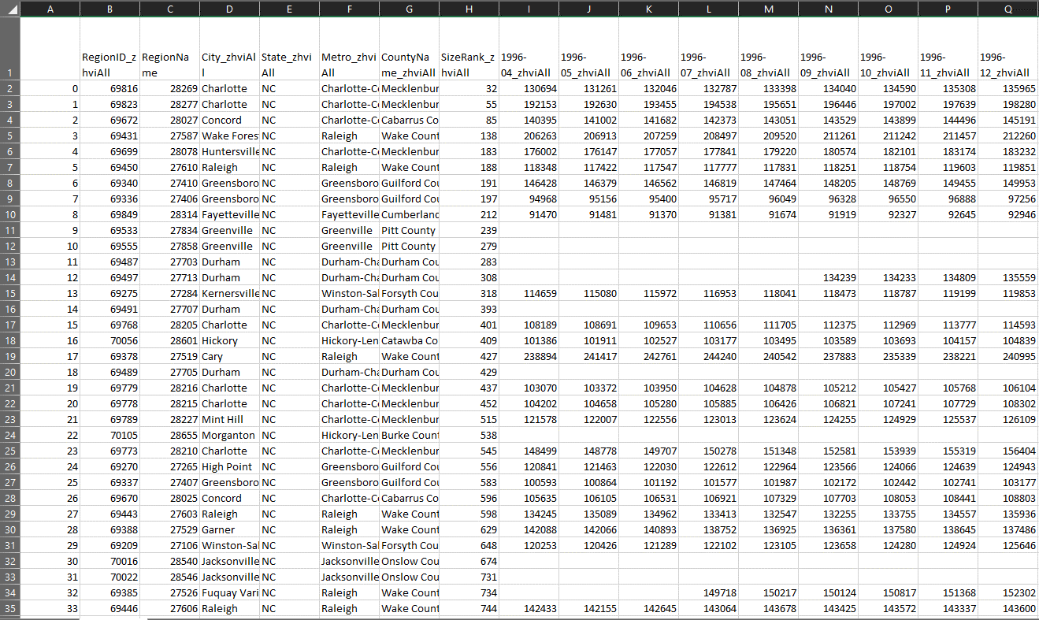
Data output:
CSV (1 per data type)
Time Series Data
1 column per metric per month
Range from 1996-Present
“RegionName” = Zip Code
Geographic data (City, State, Etc.)
Problems/cleaning required:
Merging multiple CSV’s (on Zip Code)
Thousands of columns
12 months per year x 25 years x 6 metrics!
Fortunately, names were well-structured
Notes:
Speaker: Harry

Slide 16
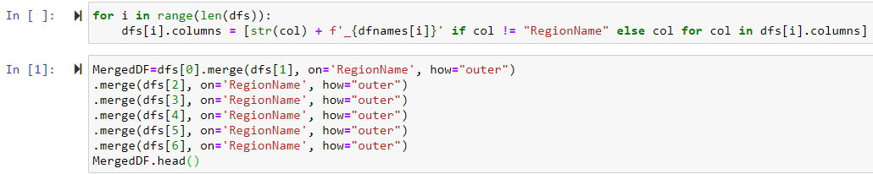
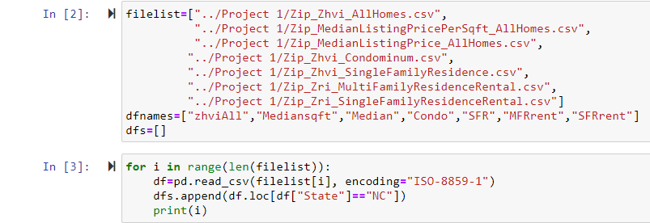
Read CSV’s into a DF
Merge the data on “RegionName (i.e Zip Code)
Notes:
Speaker: Harry

Slide 17
Data Pipeline
Extract
Get brewery opening dates from cleaned up brewery data, integrate with Zillow Data
Transform
From the date a brewery opened, locate ZHVI data at 1yr, 3yrs, and 5yrs from opening date in that zip code and all other zip codes
Calculate
Calculate metrics for 1yr, 3yr, and 5yr %change in ZHVI :
Zip codes with breweries
All other Zips
Notes:
Speaker: Joe

Slide 18
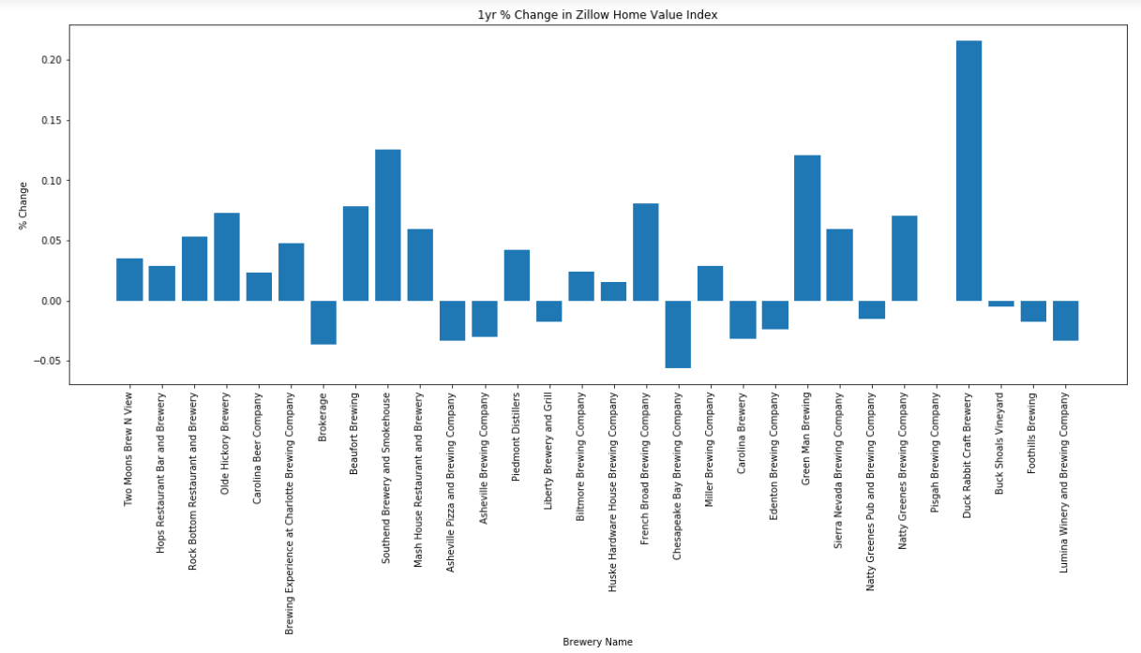
Random Sample of 1yr % change in Zillow Home Value Index
Notes:
Speaker: Joe

Slide 19
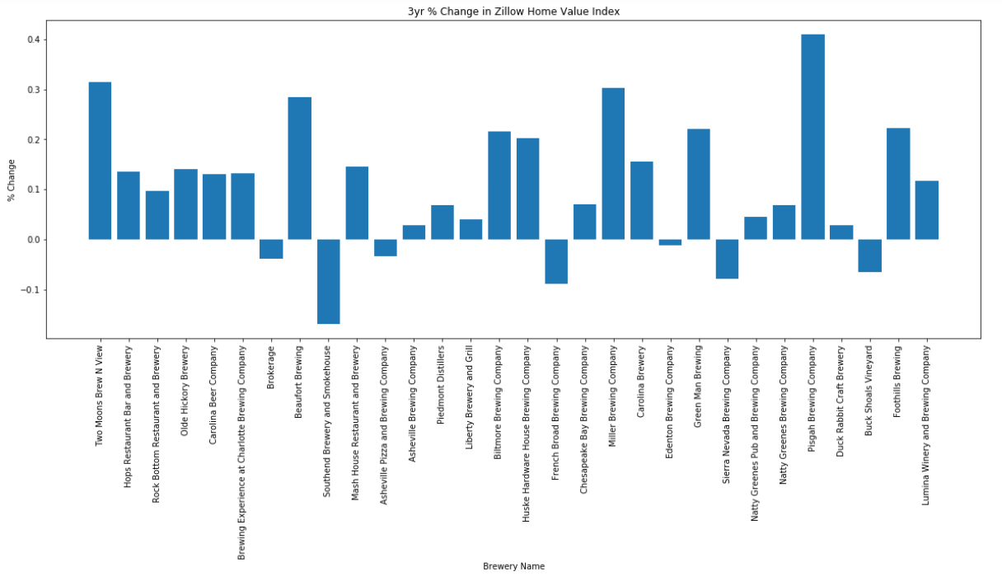
Random Sample of 3yr % change in Zillow Home Value Index
Notes:
Speaker: Joe

Slide 20
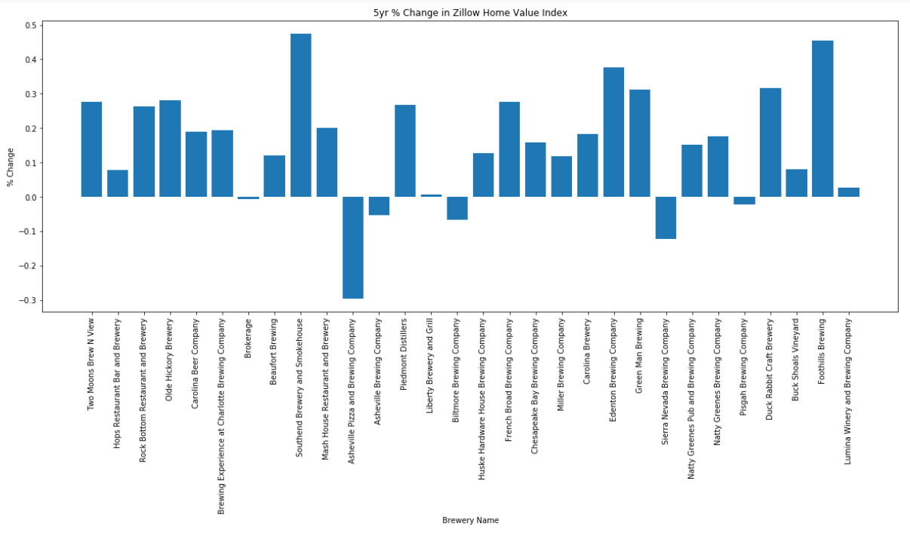
Random Sample of 5yr % change in Zillow Home Value Index
Notes:
Speaker: Joe

Slide 21
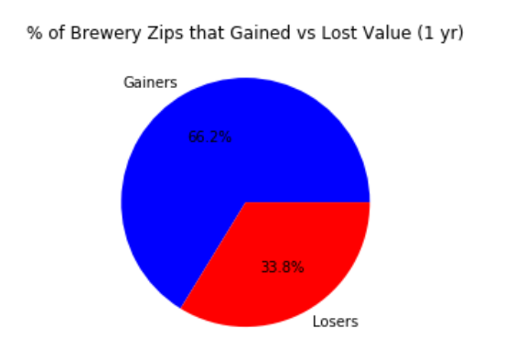
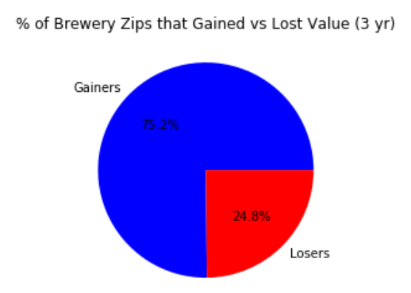
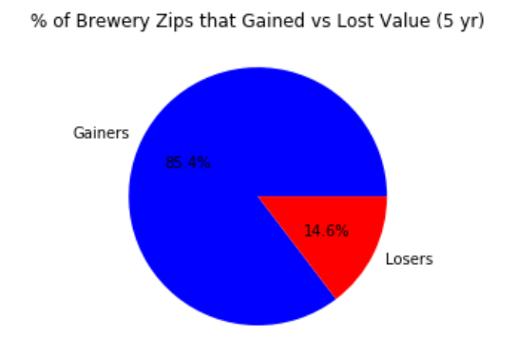
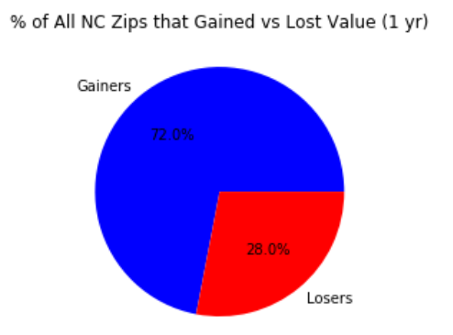
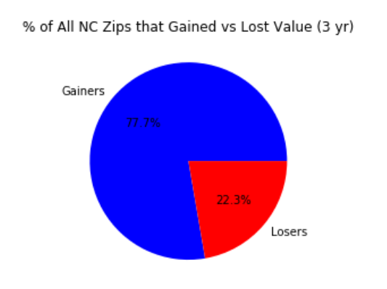
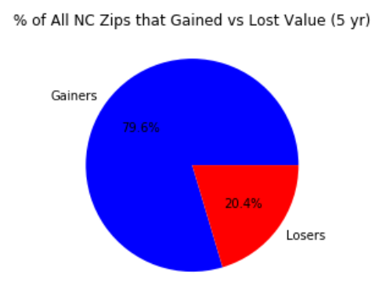
1 YEAR
3 YEARS
5 YEARs
Brewery Zips
All Zips
Notes:
Speaker: Zack Positive or negative percent change in price.
These pie plots show the % of zip codes that had a positive or negative % change in price. The top line are the zip codes that had brewery openings, the bottom line shows the entire state’s % of zip codes that gained or lost.

Slide 22
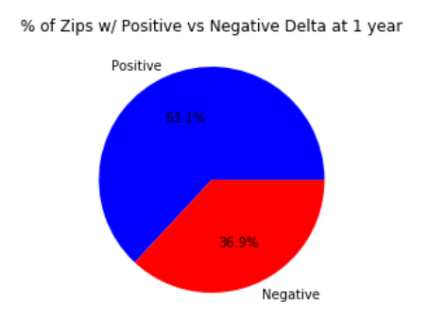
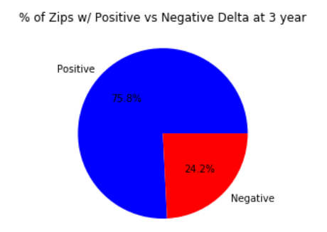
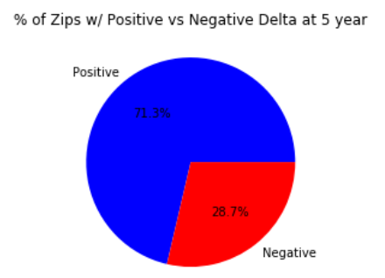
% Difference Between Brewery Zips vs. All Zips
(%Change in Price for Brew Zips - % Change in Price for All Zips)
1 YEAR
3 YEARS
5 YEARs
Notes:
Speaker: Zack. This slide compares the percentage change in price of brewery zips to the percentage change in price of NC. So over each time period, 1yr, 3yr, 5yr. These were calculated as the brewery zip % change in price – the state % change in price.

Slide 23
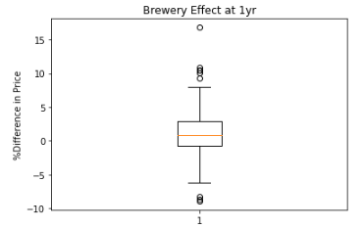
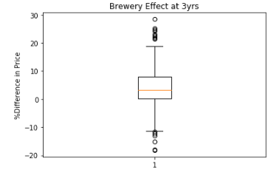
Brew Zip % increase – All Zips % Increase over same time period
Notes:
Speaker: Zack

Slide 24
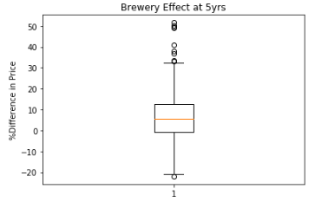
Brew Zip % increase – All Zips % Increase over same time period
Notes:
Speaker: Zack (% change in brew zips - % change in all other)

Slide 25
 | 1yr | 3yr | 5yr
Brewery Zips | 1.15% | 5.79% | 12.79%
All NC Zips | 0.01% | 2.10% | 6.90%
Delta (Brewery Zips – All) | 1.14% | 3.69% | 5.89%
Mean % Change in ZHVI by zip code type
Notes:
Speaker: Zack

Slide 26
1yr Difference: %increase in price
Notes:
Speaker: Zack

Slide 27
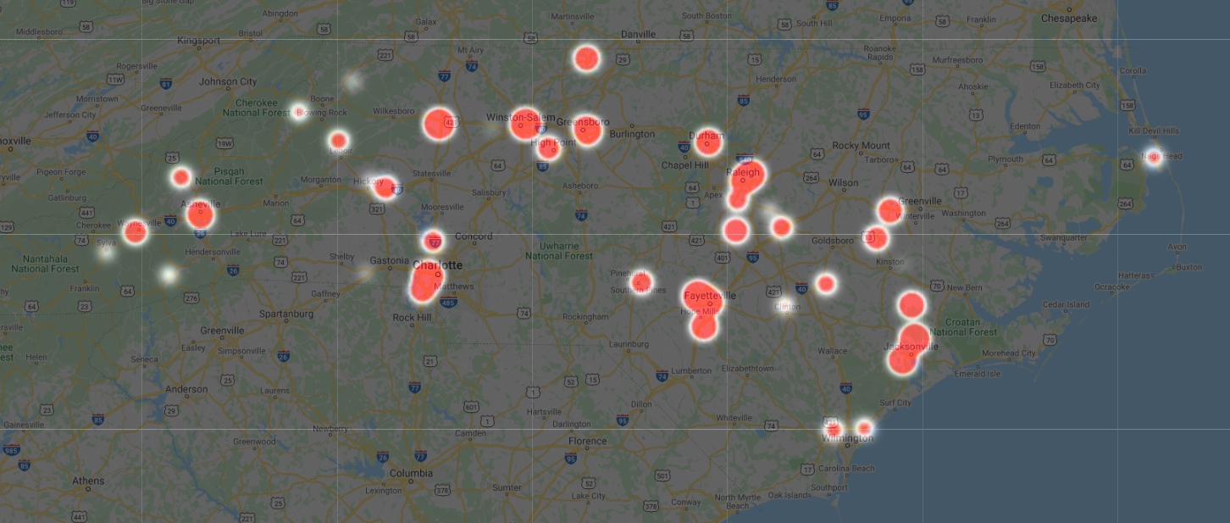
1yr Difference: %Decrease in price
Notes:
Speaker: Zack

Slide 28
5yr Difference: %Increase in price
Notes:
Speaker: Zack

Slide 29
5yR Differnce %Decrease in price
Notes:
Speaker: Zack

Slide 30
Conclusions: Buy in zip codes with brewery openings!
Zip codes with a brewery opening show a larger % increase in ZHVI over the ensuing 1yr, 3yr, and 5yr than the rest of the state.
The year in which the brewery opened did not have a substantial impact on how that Zip’s price change compared to NC (in terms of % change ZHVI)
Market size and volume are not necessarily a factor – Asheville showed some of the largest % increases.
Notes:
Speaker: Zack

